Slide 1
Basins to Boreholes
Water security and WASH monitoring – opportunities and challenges
Notes:
7 mins long presentation

Slide 2
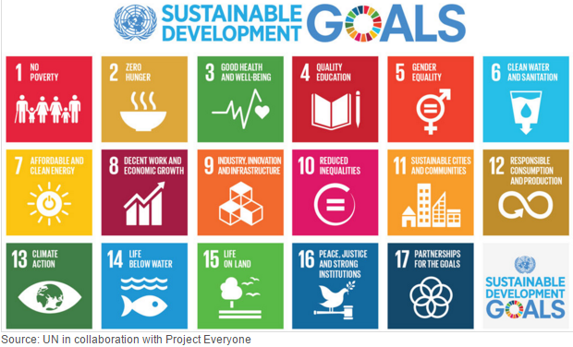
What opportunities and challenges does bringing water security into WASH monitoring offer?

Slide 3
Water security has multiple dimensions – things become complicated very quickly!!!
sustainable withdrawals
water-related ecosystems
water- efficiency
water quality
vulnerability and resilience
climate change effects

Slide 4
So, as a starting point perhaps we need to simplify and focus on the core links…
Water Resources Management
Ground water
Surface water
water quality
WASH services
Disaster risk
Climate Change shocks, stresses and long term effects
water quantity

Slide 5
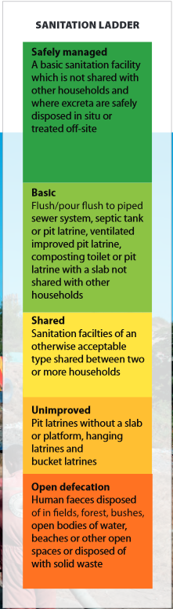
Sanitation ladder
Safely managed:
A basic sanitation facility
not shared with other households
excreta are safely disposed in situ or treated off-site

Slide 6
Gap between basic and safely managed
Adapted from: Guy Hutton and Mili Varughes (World Bank Group, January 2016).

Slide 7
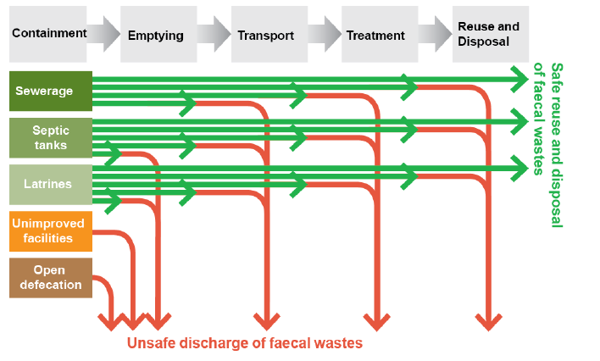
Safely managed sanitation
Lots of unknowns as to what this really means!
Notes:
Safely managed sanitation services are those that effectively separate excreta from human contact, and ensure that excreta do not re-enter the immediate environment. This means that household excreta are contained, extracted, and transported to designated disposal or treatment site, or, as locally appropriate, are safely re-used at the household or community level. Each of the following types of facilities are considered adequate if the facility is not shared with other households: a pit latrine with a superstructure, and a platform or squatting slab constructed of durable material (composting latrines, pour-flush latrines, etc.); a toilet connected to a septic tank; or a toilet connected to a sewer network (small bore or conventional).
Access to adequate excreta disposal facilities is fundamental to decrease the fecal risk and the frequency of associated diseases. The use of basic sanitation facilities reduces diarrhea-related morbidity in young children and also helps accelerate economic and social development in countries where poor sanitation is a major cause for missed work and school days because of illness. Its association with other socioeconomic characteristics (education, income) and its contribution to general hygiene and quality of life also make it a good universal indicator of human development.
Disaggregation:
By urban/rural. Further opportunities for disaggregation to be reviewed.
Comments and limitations:
Since this indicator is quite ambitious and the objective is progressive elimination of inequalities in access, an intermediary indicator to measure universal basic access by 2030 could be “Percentage of population using basic adequate sanitation.”
In addition, this measure does not fully measure the quality of services, i.e. accessibility, quantity, and affordability,
or the issue of facilities for adequate menstrual hygiene management.

Slide 8
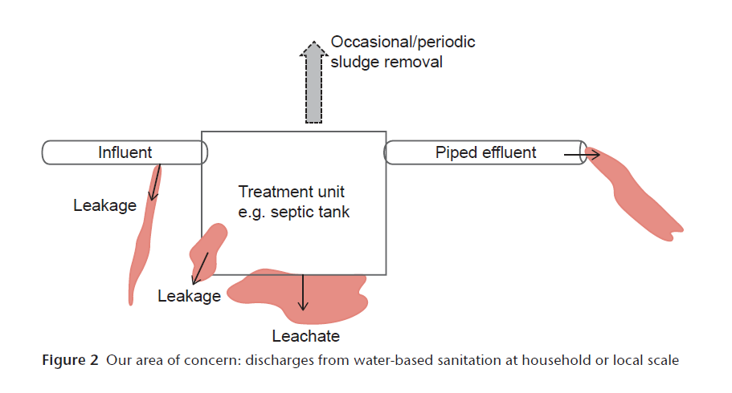
Making pathogen hazards visible
Investing in sludge treatment facilities and desludging only treats part of the problem
Need better ways to understand hazards and exposure at the local level to more effectively manage pathogen risks
Source: Mitchell at al (2016) Making pathogen hazards visible: a new heuristic to improve sanitation investment efficacy
Notes:
Summarise from this and full paper:
The public health objective of sanitation is to reduce the risk of negative health outcomes from faecal contamination. For water-based sanitation systems at the household and
community scale as practised in Indonesia and perhaps elsewhere, the liquid component of the effluent comprises a significant pathogen hazard. While increasing attention is paid to managing the solid fraction, the hazard in the liquid fraction goes largely unnoticed and unmanaged. This paper proposes the means for a conceptual shift to a focus on the pathogen hazards that matter post-treatment, and where those hazards enter the environment, enabling improved local risk management. Firstly, the paper proposes exponential, rather than arithmetic, representations of pathogen number or concentration, because arithmetic representations of treatment efficacy wrongly suggest low cause for concern. Secondly, the paper introduces and applies the Pathogen Hazard Diagram, a new heuristic applicable at both the local and national scale, that requires only local knowledge and general sanitation reference knowledge to construct, but which can guide policy and action, direct monitoring, and improve the efficacy of sanitation investments.

Slide 9
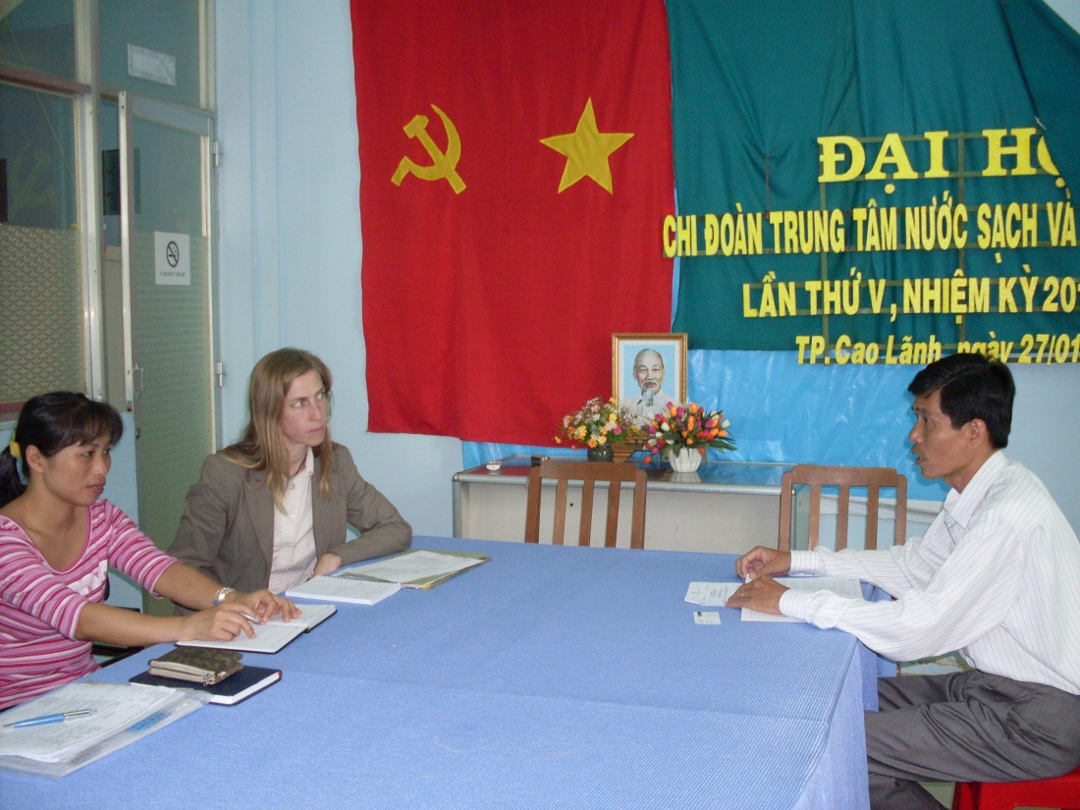
Developing effective national country WASH monitoring systems and promoting sharing of data across ministries and stakeholders
Global monitoring
National monitoring

Slide 10
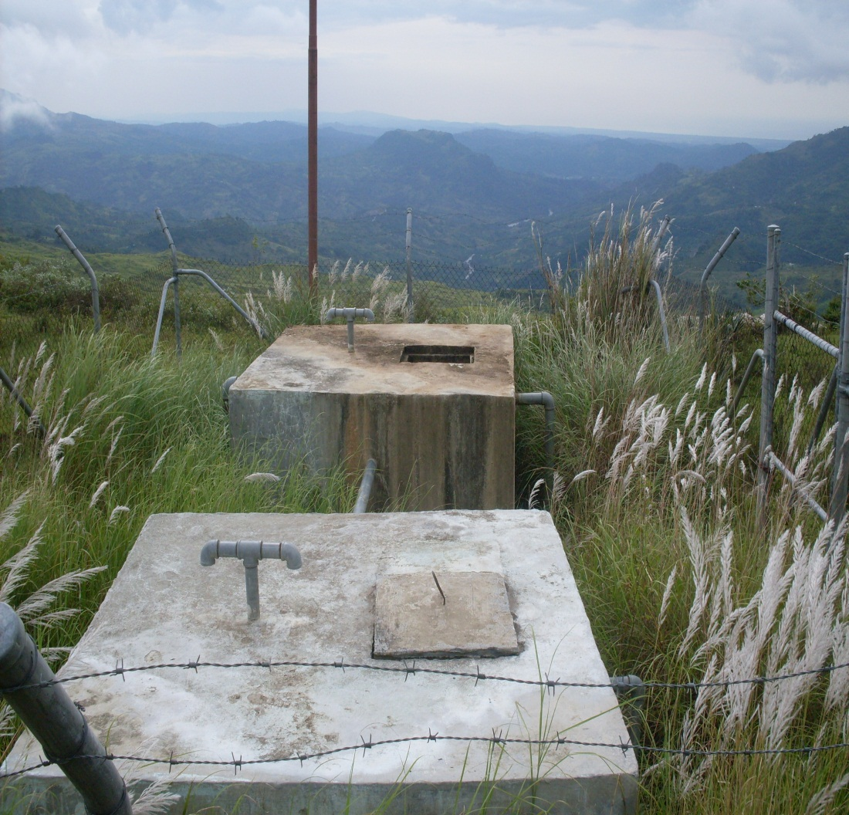
Local government roles in monitoring of water security and WASH become critical
Global monitoring
National monitoring
Local monitoring

Slide 11
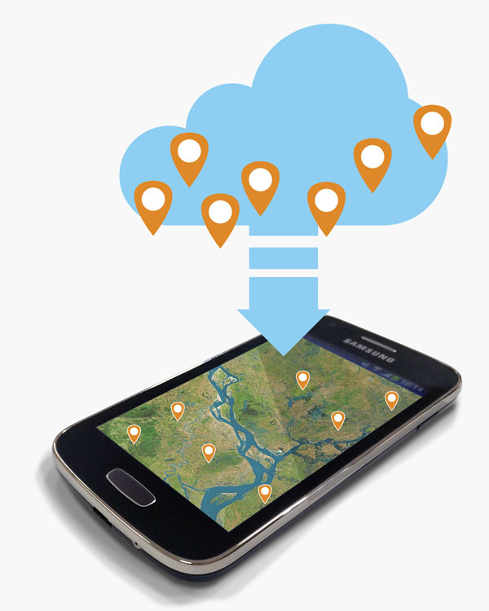
Innovations are part of the way forward, including both technological as well as institutional
ICT aids in data collection, transfer, analysis and use
Can support monitoring functionality, coverage, and aspects of vulnerability
Can support monitoring of water resource and watershed conditions
Can support integration of tools, data and analysis
ICT is only useful if fit-for-purpose, situated in a functional institutional setting where there is alignment between information supplied and demanded, and incentives for both compliance and use

Slide 12
Key messages
1. WASH monitoring needs to evolve to incorporate or at least closely link to several dimensions of water security
2. “Safely managed” presents some new challenges, especially for wastewater treatment
3. Monitoring requires effective country led systems that facilitate data-sharing across ministries and stakeholders, and on local level monitoring, which is critical in the context of water security
3. Innovations are part of the way forward, including both technological as well as institutional
4. Development agencies should focus support on effective country-led systems

