Slide 1
The network value of distributed generation
Dr Scott Kelly, Institute for Sustainable Futures
Jay Rutovitz, Ed Langham, Lawrence McIntosh
Australian Utility Week 2016, Sydney
30th November 2016

Slide 2
Research questions
What are the long term costs and benefits of an lgnc?
    At a macro level what is the Total Economic Cost over the long term?
    At a consumer level what is the effect on consumers electricity bills?
Economic and Scenario modelling
How might peak network demand (MW) grow under different scenarios?
How might net imports and net exports change over time?
What are the economic costs and benefits of an LGNC and avoided network augmentation?

Slide 3






model hierarchy
A.
B.
C.
G.
H.
I.
D.
E.
F.
Sub transmission
High voltage
M.

Slide 4
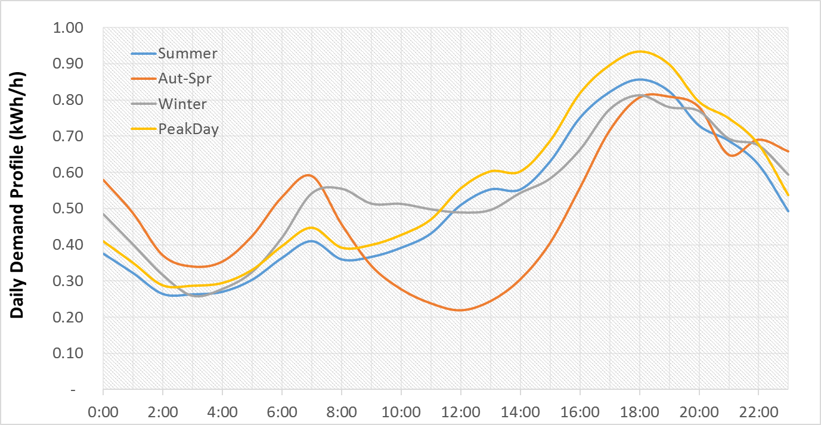
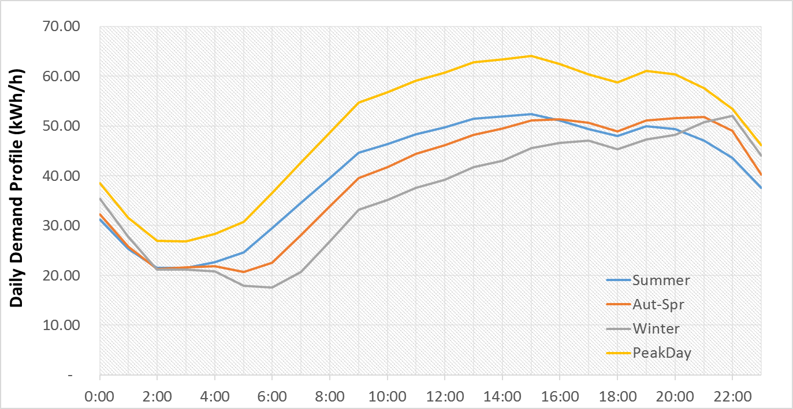
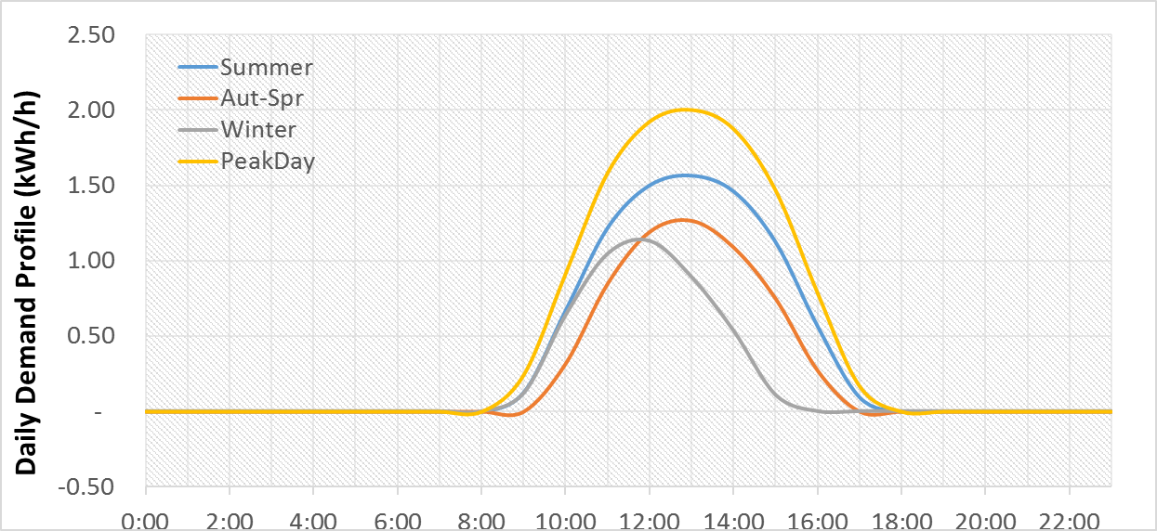
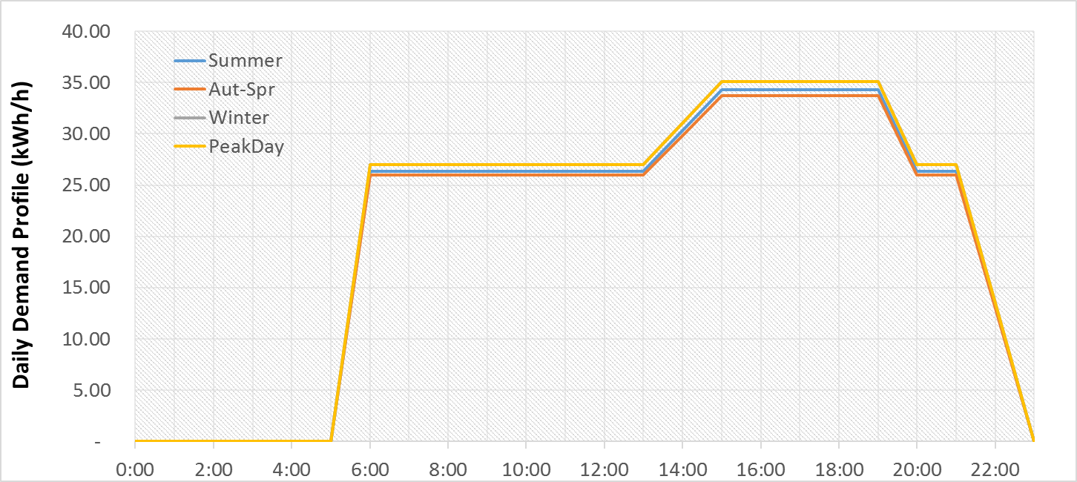
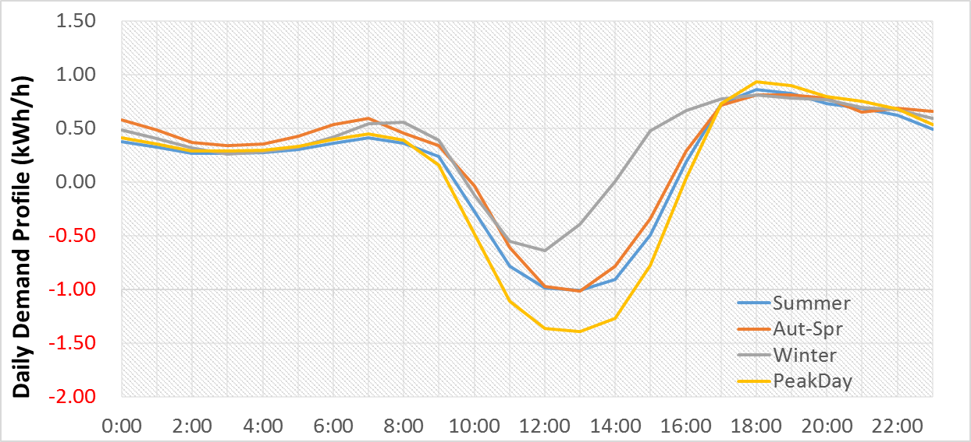
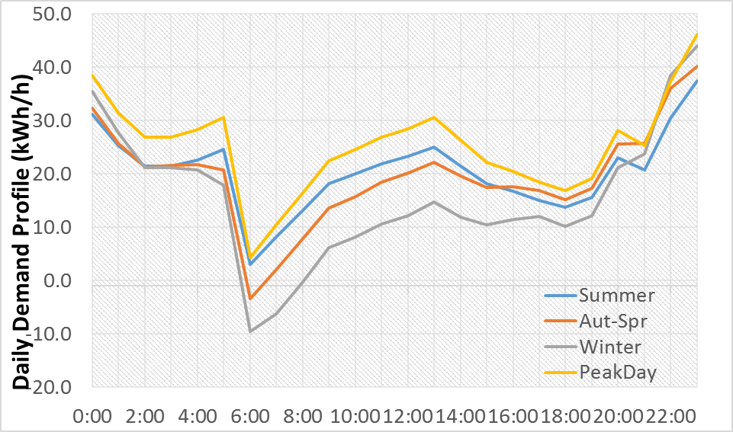
Representative agent model
Residential + PV
Commercial + Cogen

Slide 5
MODEL Limitations
Long time horizons and uncertainty in rapidly changing market
Deterministic model with two exogenous scenarios
Approximates each customer category as an average representative ‘agent’
Does not include costs of upgrading network to handle increased distributed generation
Does not include savings associated with replacement expenditure savings associated with downsizing
Data for one state only – looking to expand!

Slide 6
Scenario assumptions
Customer numbers, capacity and generation are for NSW
LGNC payments are NOT made to existing generation
LGNC payments are NOT made to generation under <10kW
Networks have sufficient capacity to avoid investment until 2025 (~600MW)
80/20 benefit share (80% benefit goes to generators / 20% to Networks)
Growth projections are modelled from AEMO projections
LRMC values independently estimated from Energeia work
Costs (augmentation and LGNC payments) allocated to customers on a volumetric basis

Slide 7
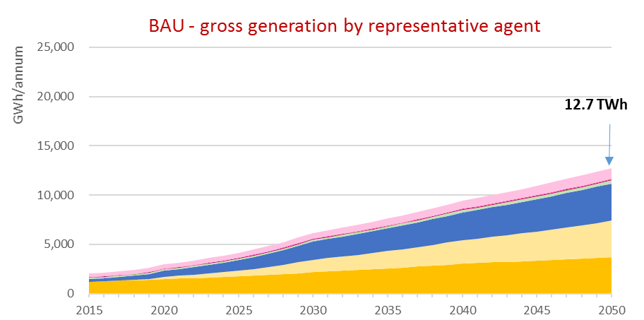
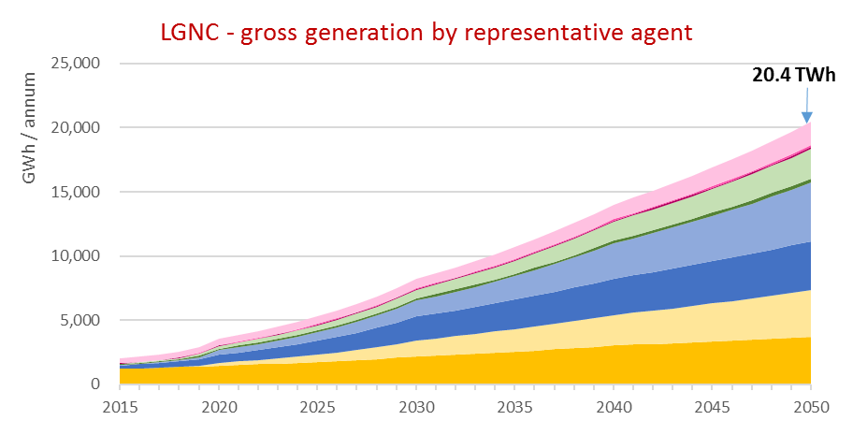
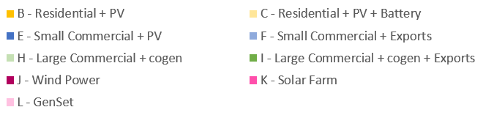
Gross generation

Slide 8
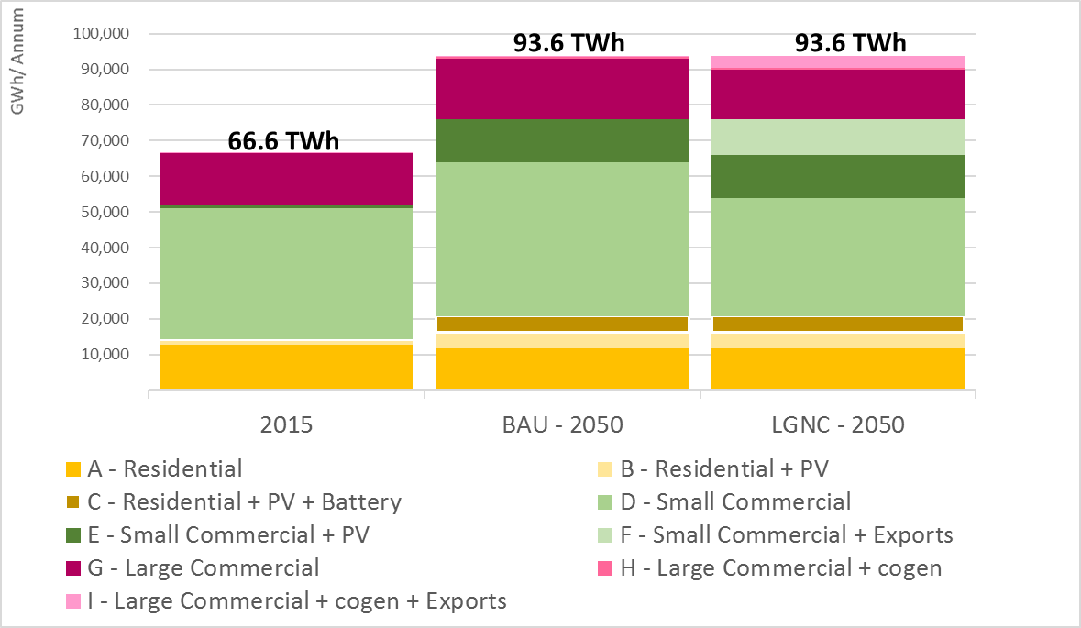
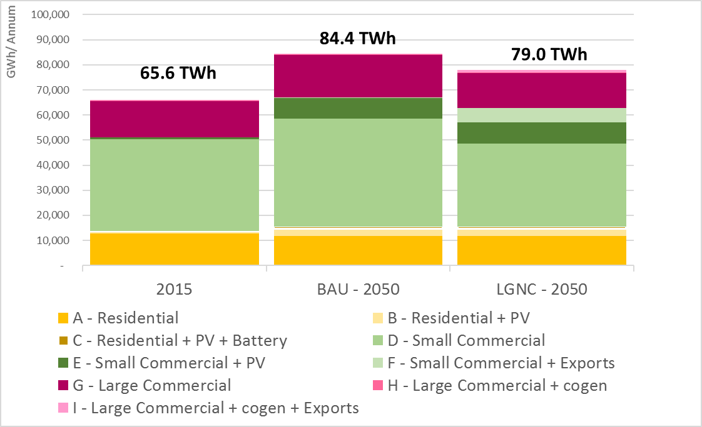
Consumption
Gross Consumption
Net (Import) Consumption

Slide 9
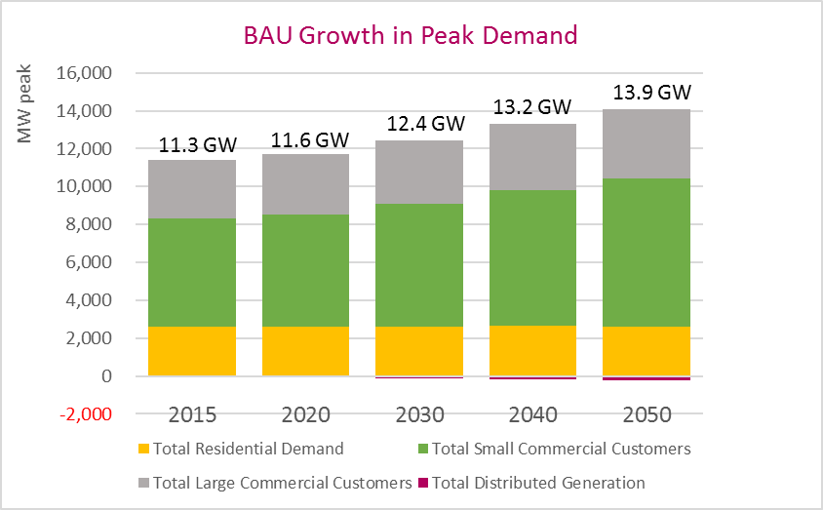
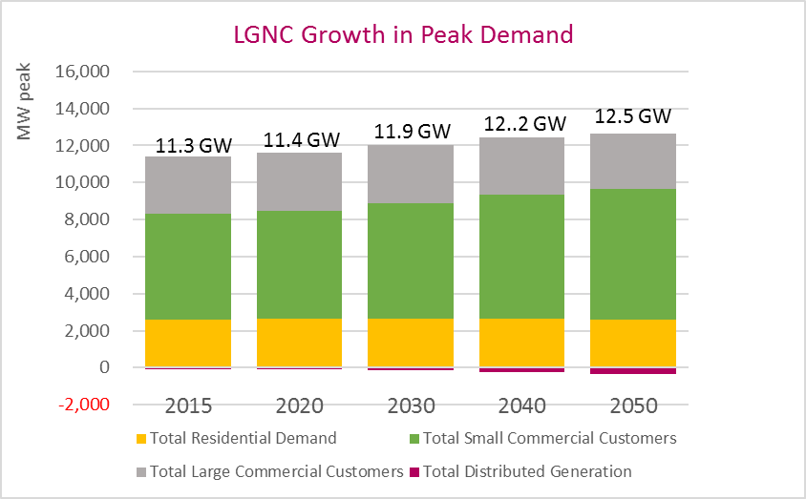
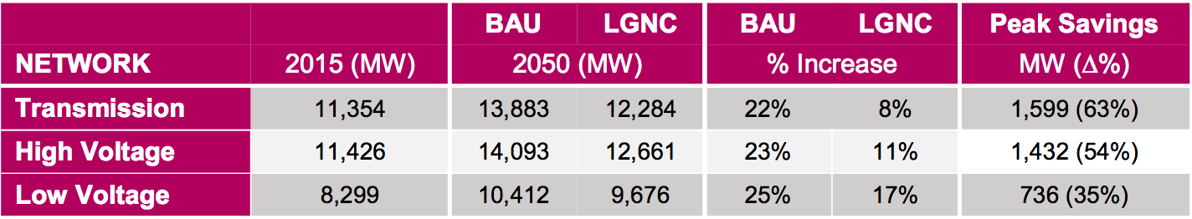
Growth in peak demand

Slide 10
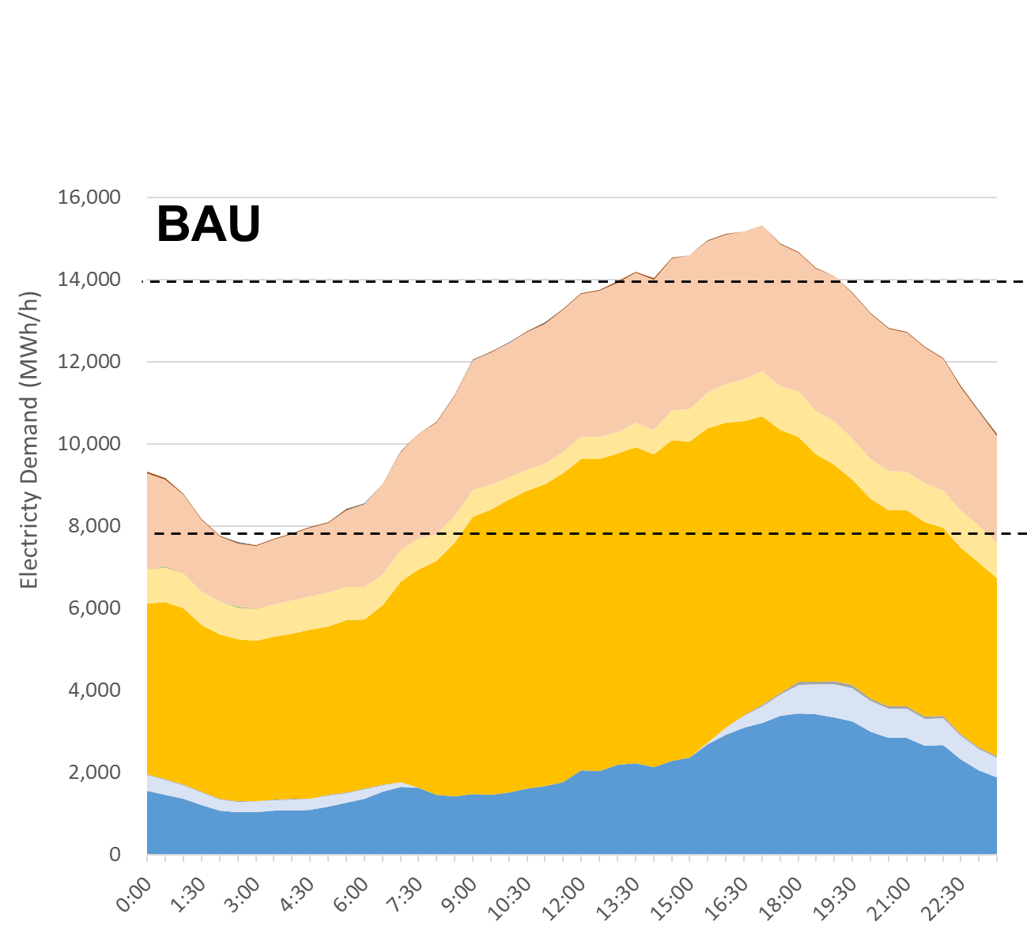
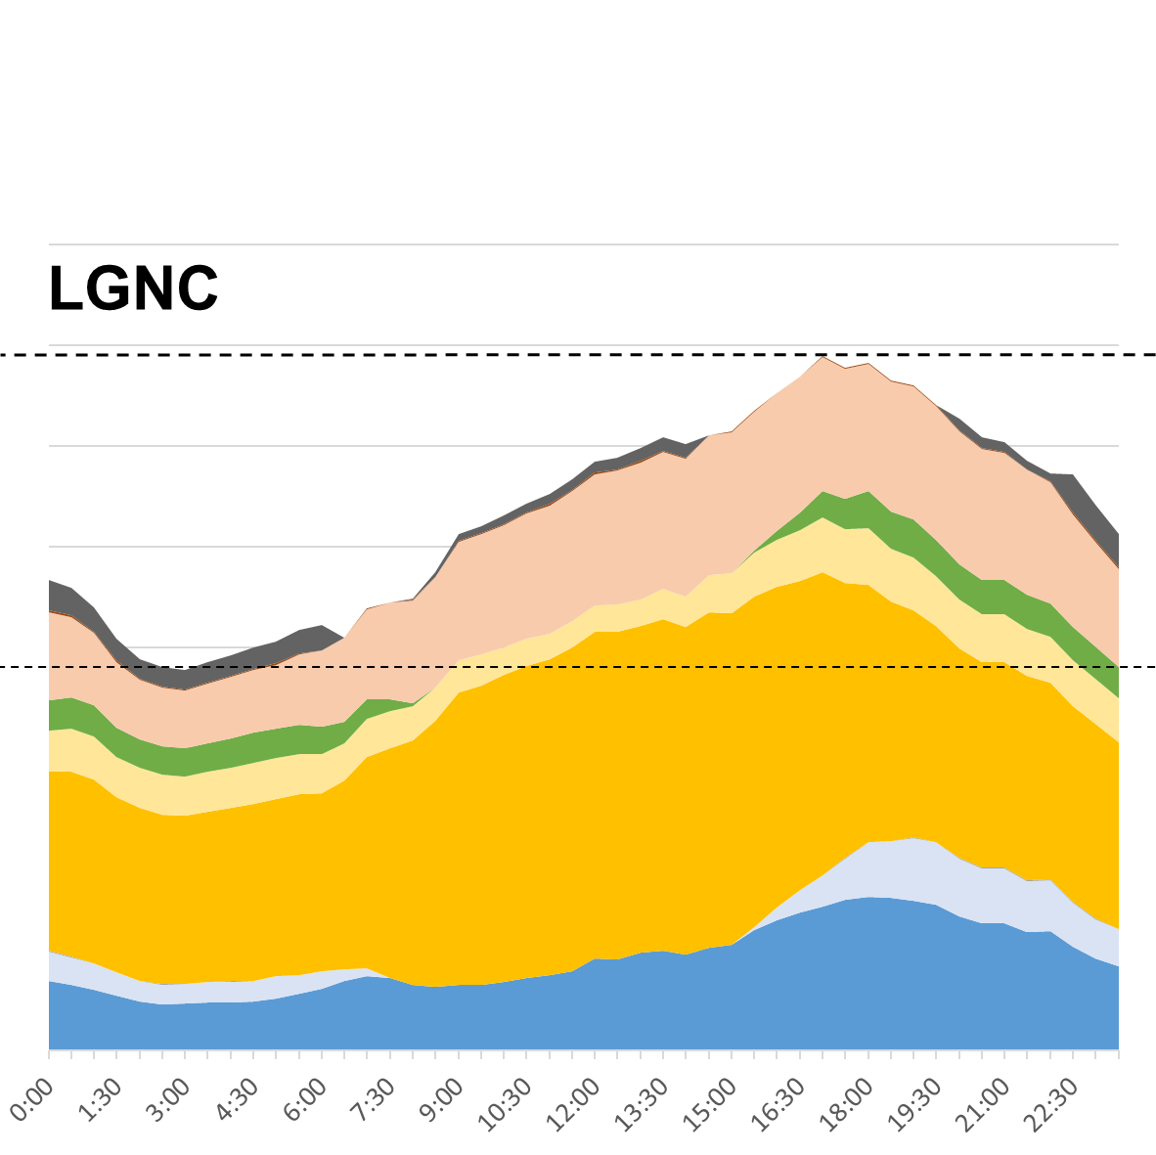

Change in peak profile in 2050

Slide 11
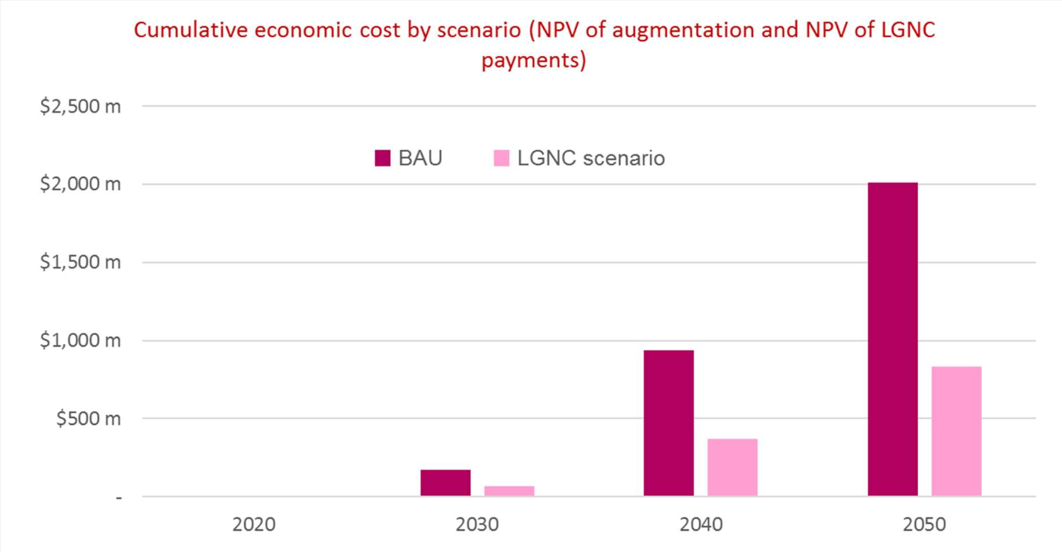
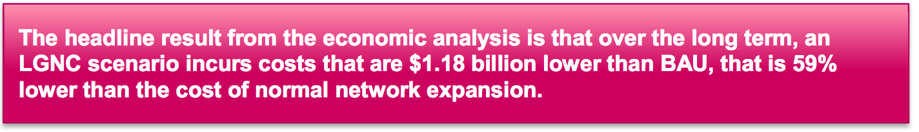
Economic costs and benefits
$1,181 m
$567m
-$6m
$104m

Slide 12
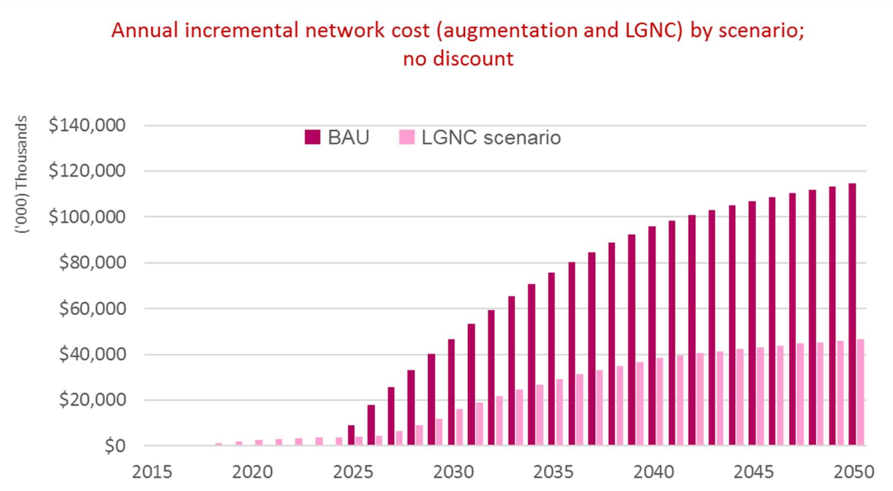
Incremental costs

Slide 13
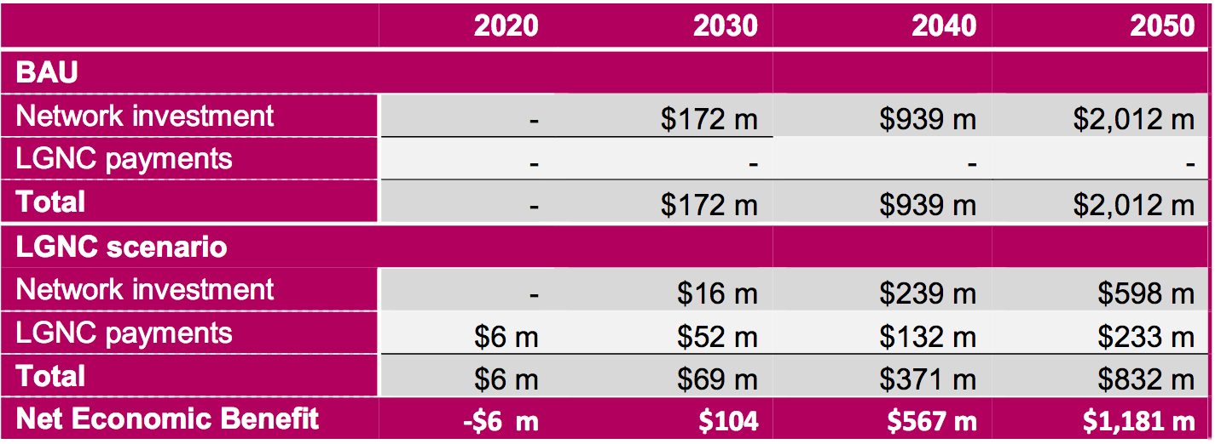
Economic costs and benefits
Cumulative economic cost by scenario (NPV of augmentation and NPV of LGNC payments)
Network: weighted average of Ausgrid and essential parameters (66%, 34% Essential)

Slide 14
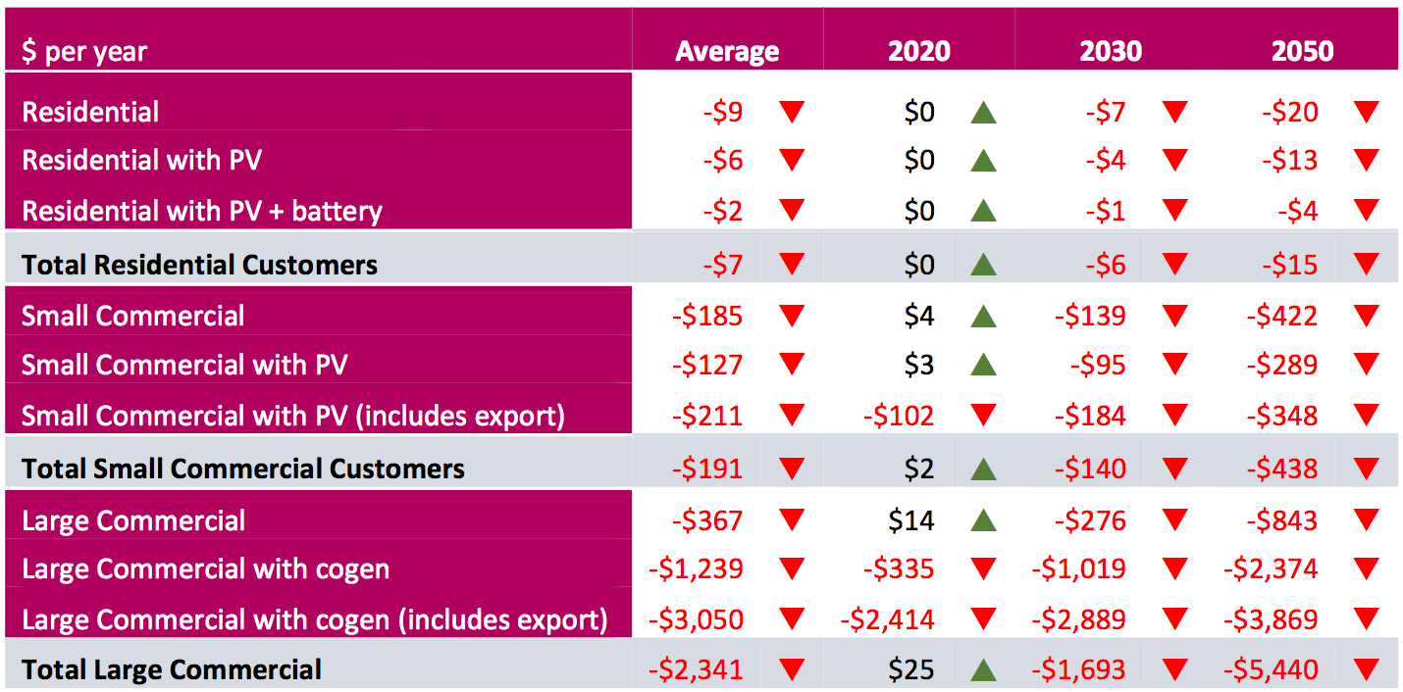
Impact on consumer bills
All consumers see decreases in their average annual electricity bills

Slide 15
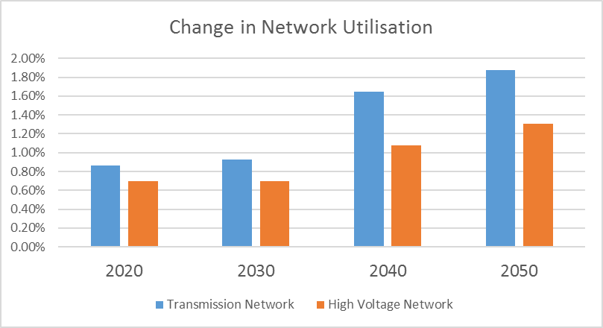
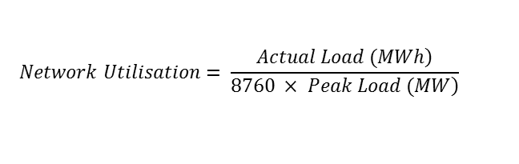
Network utilisation
$$Network Utilisation= \frac{\left.Actual Load (MWh\right)}{\left.8760 × Peak Load (MW\right)}$$
avoided augmentation from System losses
Electricity losses from GWh avoided | 2015 | 2020 | 2030 | 2040 | 2050
Transmission / System | $0.0 m | $0.3 m | $6.0 m | $15.8 m | $28.1 m

Slide 16
LGNC paid to SMALL systems? (<10 KW)
Recommend excluding systems < 10kW as economic benefit increases by $113m to 2030 (from $-9m to $104).

Slide 17
What happens if demand growth is flat?
    Sensitivity testing for range of demand growth rates
    Net economic benefits are highly asymmetric because the marginal value of an avoided kW is 2.5 times the price of an LGNC payment.

Slide 18
OTHER Sensitivity
The year network augmentation is first required
Rate of growth of local generation in the LGNC scenario compared to BAU
Including non-locational transmission costs in the LGNC payments.
RESULT: benefit is reduced for later years; all cases tested had long term benefit
RESULT: in general, more local generation increased the benefit
AUSGRID PARAMETERS
RESULT: no significant effect

Slide 19
Conclusion
The LGNC scenario has network costs that are 60% lower than the costs of BAU
Total Economic Costs and Benefits
 | 2020 | 2030 | 2050
(Cost) Benefit | ($6 m) | $104 m | $1,180 m
All customer categories will see reductions in electricity bills between 2025 and 2030
Our conclusions are robust to a range of sensitivity tests
  Growth in distributed generation (-50%/+50% -> $213m/$1,442m)
  Change in growth of underlying peak demand (below 0.2%)
  Available spare capacity on the network (2030 -> $655m)
Through this modelling we are able to make the following recommendations:
  Exclude distributed generators below 10kW and above 30MW
  Exclude all existing distributed generators
In the worst case scenario the LGNC will cost nothing in the best case scenario it will save hundreds of millions for NSW and billions for Australia

