Slide 1

Community Engagement
For Local Government Councillors
It is the business of council to involve the public in the business of government
Presentation prepared by the Australian Centre of Excellence for Local Government

Slide 2

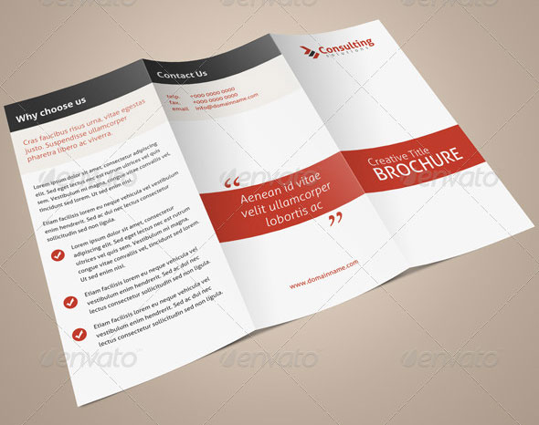

Community engagement: What is it?
Reaching out to communities to -
Provide or ask for information
Identify interest in an issue
Seek ideas on what can be done
Test proposals
Its value is in both getting the result and how you get it

Slide 3
What is it?
It can be a little engagement or it can be a lot of engagement
The community engagement spectrum:
Information
a one-way relationship in which local government delivers information to citizens
Consultation
a two-way relationship in which citizens provide feedback on issues defined by local government
Active participation
a collaboration in which citizens actively shape policy options, but where local government retains the responsibility for final decisions

Slide 4
Why do it?
Make better decisions
Be transparent & accountable
Empower the community

Slide 5
Make better decisions
Good Decisions are based on information and views from many sources
Councillors are elected based on their knowledge, experience and views
But they are also required to make decisions collectively and to listen to all stakeholders
This can mean putting aside strong personal views for the sake of good governance

Slide 6
Be accountable and transparent
Transparency is at the heart of democratic governance -
Local government legislation requires you to consult with residents when making local laws and in planning
Democratic principles require you to engage broadly in carrying out all functions
Legal rights to information + judicial review of decisions + an active media = your actions are open to scrutiny

Slide 7
Empower the community
Involving citizens is rewarding for them because -
They get to have a say
They feel included and valued
They form social networks that connects them to others in the community
They build understanding about public affairs
All this builds a strong and resilient community

Slide 8
Why is it good for council?
Engagement reduces criticism of decision-making processes
Helps achieve consensus
Leads to more defensible decisions
Council earns respect for enabling people to have a say and get involved
Builds a better relationship between council and community
Helps council understand the political pressures faced in dealing with an issue

Slide 9
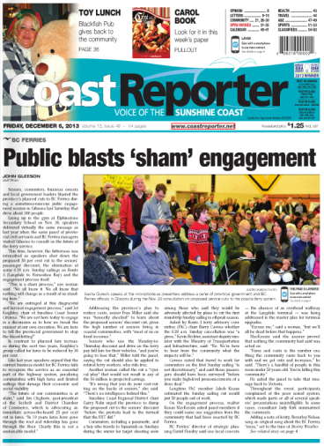
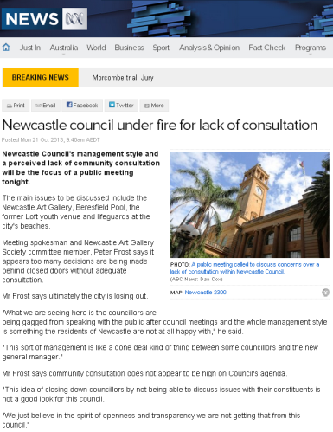
What happens if you don’t do it well?

Slide 10
What do councils tend to engage about?
Common topics for engagement by councils are:
Corporate planning, community planning and land use planning
The design and location of new infrastructure including roads and other developments
Specific programs, e.g. sport, recreation, employment, training, crime prevention, flood mitigation, tourism
Youth Issues
Local government service levels and standards
Input into state/federal issues, e.g. alcohol management, housing, health

Slide 11
What is the role of councillors?
Councillors represent their community by:
Understanding needs, aspirations and priorities
Considering all relevant information and options
Making decisions about what to do and how
Communicating council’s decisions
Implementing council’s decisions
Being accountable and transparent
Which of these require community engagement?

Slide 12
When do councillors need to engage?
Role of councillors | Community Engagement
When a councillor is: | They might need to:
Getting to know community needs, aspirations and priorities | Consult about new plans and laws Listen to people during everyday contact (conversations, letters, emails)
Considering options for action | Consult affected people or groups Involve people & experts in assessing the options
Making decisions
Communicating decisions | Provide information to the public
Implementing decisions | Consult affected groups about the details of where and how Provide progress reports to the public
Being accountable and transparent | Provide information to the public Be available to answer questions

Slide 13
How to create an engagement culture?
Councillors are leaders and ‘set the tone’ for a council – they can create an engagement culture by:
Believing it is important
Taking time to improve engagement skills
Ensuring frontline staff receive training in community engagement and communications
Ensuring staff have adequate resources for engagement
Building ‘engagement thinking’ into everyday practices
  How can staff use interactions with residents to better inform or interest them in council affairs?
  Do staff reports to council include information on how the community was engaged?

Slide 14
What is the role of council staff?
Staff manage engagement exercises by:
Identifying needs and advising council
Devising approaches in consultation with councillors
Considering the broader context (e.g. other activity in the area) and seeking to coordinate with similar activities

Slide 15
How councillors can work with staff?
Councillors and staff have mutual responsibilities in supporting a council’s community engagement effort
Councillors make a community engagement policy
ensure training and development for staff
allocate budget for engagement
create an engagement culture
Staff manage community engagement processes
advise and assist councillors
report to council on engagement outcomes

Slide 16
Why a policy may be a good start?
A Community Engagement Policy:
  states council’s commitment to engaging the community
  sets out the principles that guide council’s approach
Developing a policy:
  is a process for council to discuss how it wants to do this (gets everyone ‘on the same page’)
  demonstrates to the public that council is serious
  gives guidance to staff and individual councillors

Slide 17
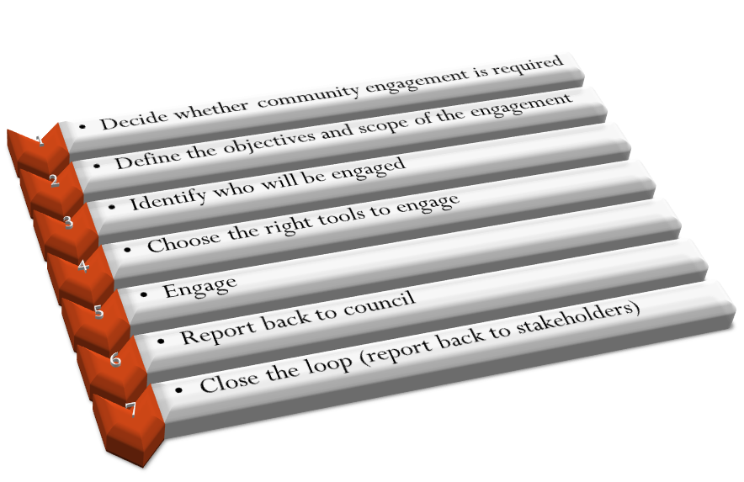
How to engage for a specific project

Slide 18
Tips on Engagement - Process
Involve key people and groups in planning the exercise
Define the issue precisely and be clear about what can be achieved
Make sure everyone knows the limits to the process (non-negotiables)
It’s about listening first; explaining and defending a decision comes later
Don’t assume you ‘get it’ all after one meeting – keep listening
Expect conflict and have a strategy for dealing with it
Ensure there are at least small outcomes along the way
Have a communications plan for regular feedback, to let people know their input is valued and to get more people on board

Slide 19
Tips on Engagement - Culture
Token consultation efforts will annoy and alienate people
Acknowledge any divisive history which could be an obstacle
People often just want to actually be heard
Celebrate achievements and thank contributors
Don’t get disheartened – focus on strengths not weaknesses
Council staff have a big role to play – ensure they have resources and training

Slide 20
Take Home Messages
It’s about better decisions and happier residents
The skills of effective engagement may come more easily to some, but a good councillor knows to:
L isten more than they talk
E ngage early and often
A lways give feedback and reasons for decisions
R einforce engagement culture
N eed advice from, and give support to, staff

